Slide 1
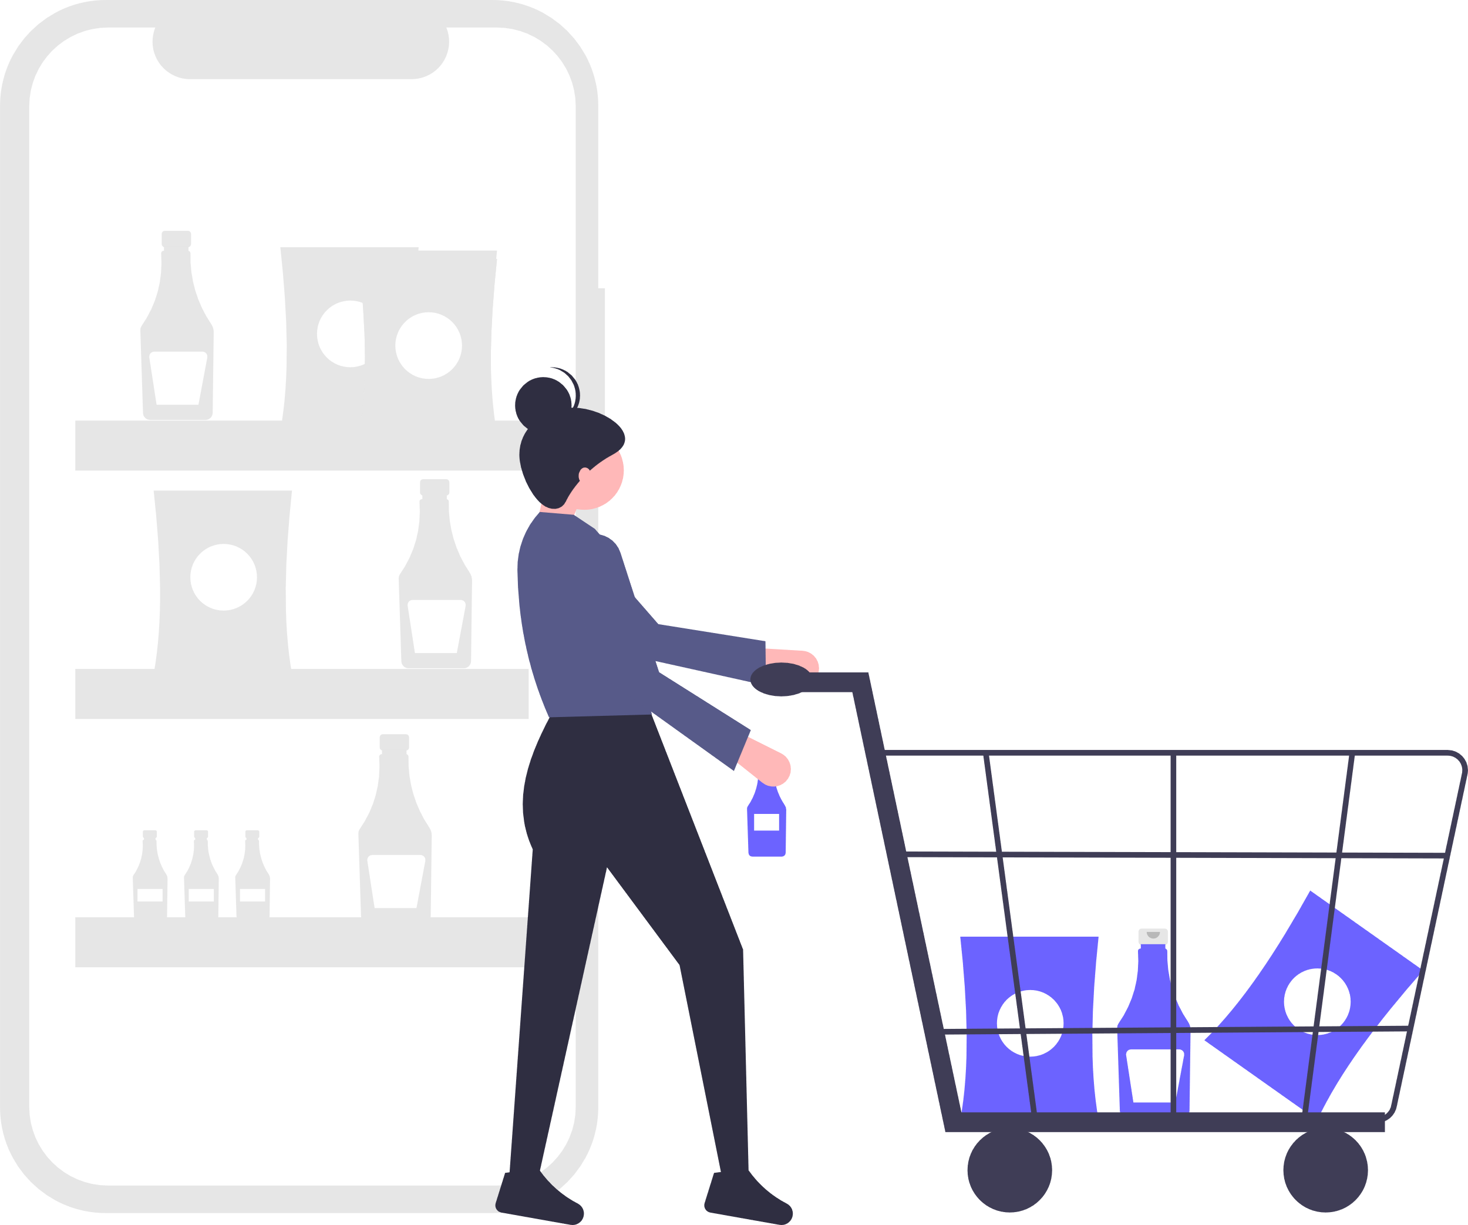
Private Grocery Manager
Barbar Ahmad, Giuliano Spagnuolo, Julius Sange

Slide 2
Agenda
Goal Definition
Program Architecture
Database Schema
Presentation of the App

Slide 3
Goal Definition
Main Idea
Service to Manage Groceries
Scan Products with their barcodes
Create Shopping Lists
Create Recipes
Goal:
Central inventory Management System
Potential Customers:
Students
People who live in a shared apartment

Slide 4
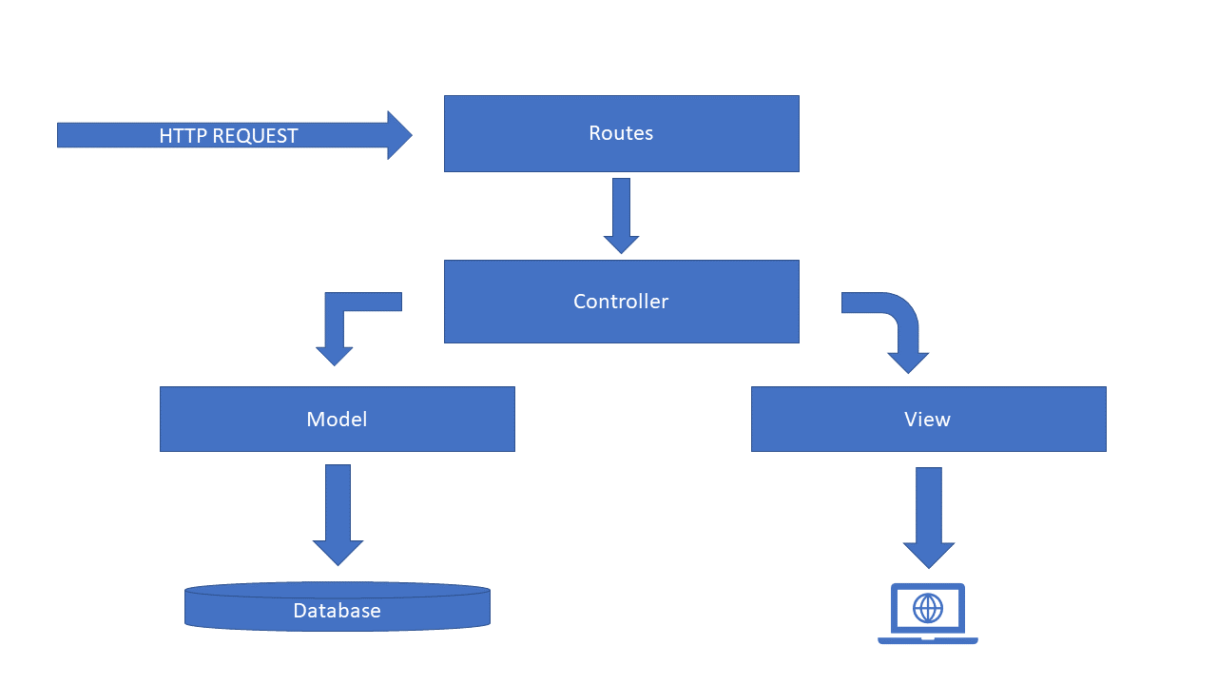
Program Architecture

Slide 5


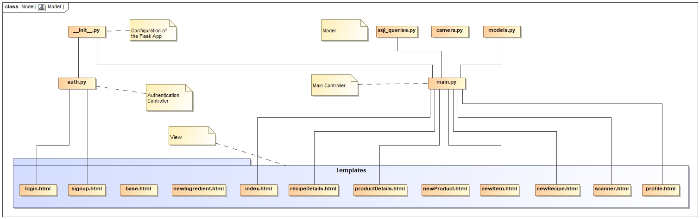




Slide 6
Route / Controller / Model
@main.route('/allRecipes')
def all_recipes():
recipes = db.get_all_recipe()
return render_template('tableViews/allRecipes.html', recipes=recipes)
def get_all_recipe():
result = ENGINE.execute('''Select id, name,dificulty,time From Recipe''')
answer = result.fetchall()
id_name_pairs = list()
for row in answer:
id_name_pairs.append((row[0], row[1], row[2], row[3]))
return id_name_pairs

Slide 7
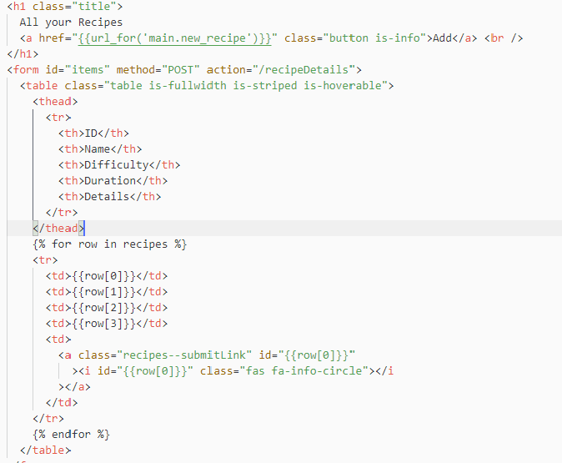

Slide 8
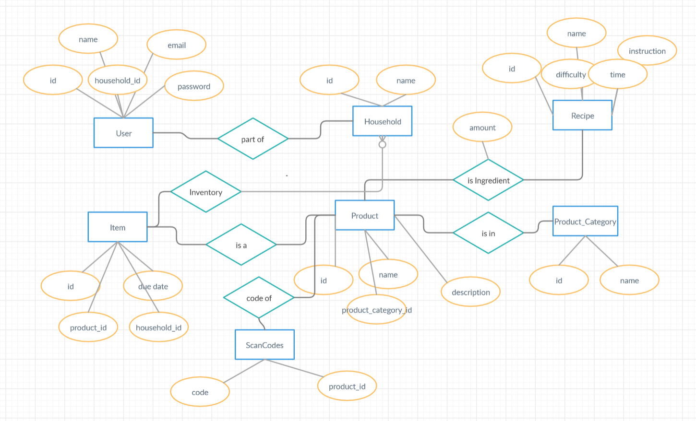
Database Schema

Slide 9
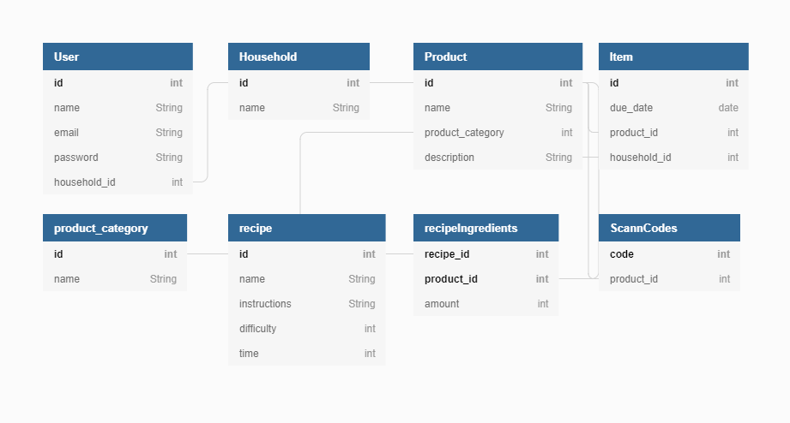
Database Schema

